Slide 1
Impact of Experiential Ocean Science Education on Scientist-Volunteers’ Knowledge, Teaching Capacities, and NSF Broader-Impacts Endeavors
Fritz Stahr, Ocean Inquiry Project
Andrea Anderson, Sound View Evaluation and Research

Slide 2
Ocean Inquiry Project
Boat-based education & research program
Staffed by volunteer-scientists—more than 70 since 1999
Serves adult participants as well as K-12 and colleges
Flexible to both educational client program needs and collaborative scientist needs
Real data and samples collected on water properties and plankton using CTD, Niskin bottles, & nets
Baseline data at multiple sites on Puget Sound
Partner of COSEE Ocean Learning Communities since 2008

Slide 3
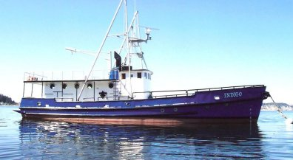
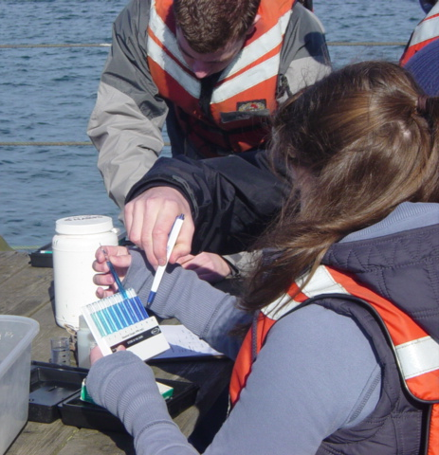
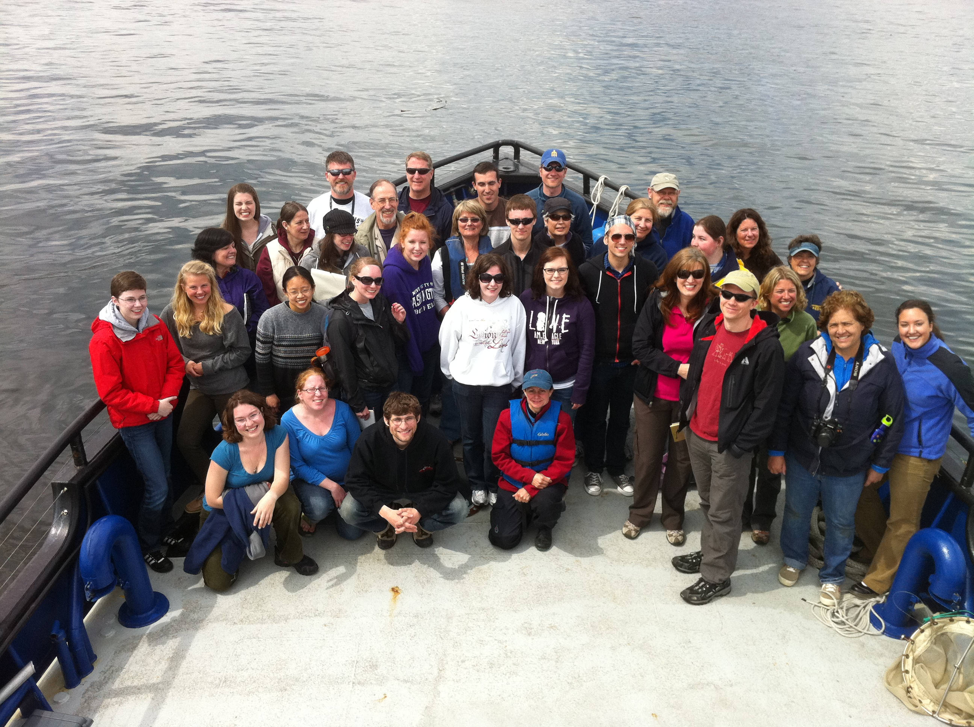
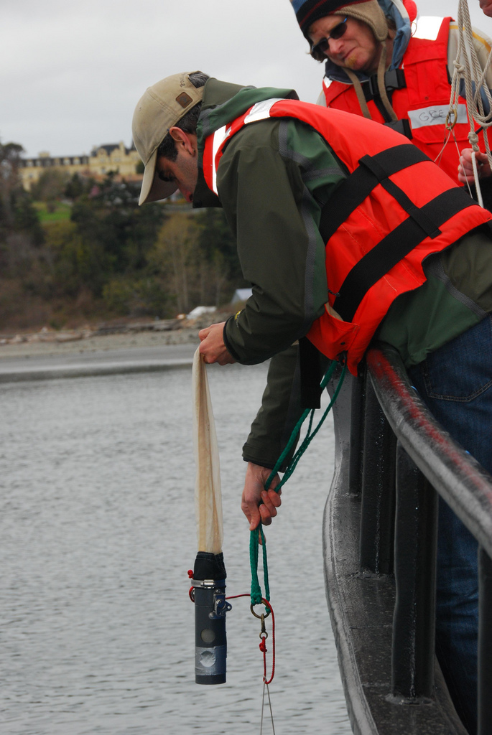
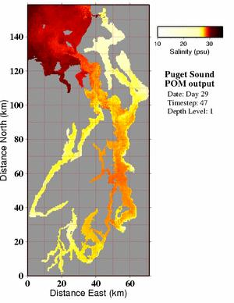
Ocean Inquiry Project
WHAT HAPPENS ON A CRUISE?

Slide 4
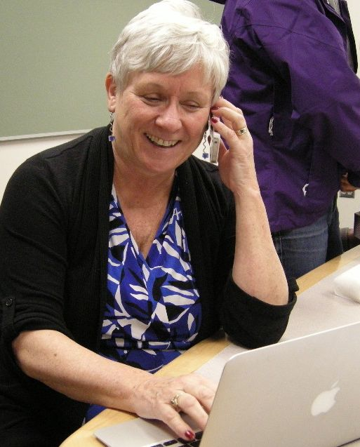
Study purpose and methods
Purpose: NSF Geosciences interested in how COSEE is affecting scientists’ education & outreach efforts
Method: Grounded Research Interviews to create impact categories
Target population: 36 volunteers during the OIP’s COSEE era (2008 - present)
Sample: 16 volunteer-scientists and 2 NSF-funded PIs who are beneficiaries of OIP efforts
Notes:
Note that NSF-GEO funds COSEE and spends ~10% on evaluation
Discuss what “grounded research interviews” means –
Social science methodology to create theory around an unstudied phenomenon
Uses rich data – like interviews — and through iterative coding of statements, can develop categories or themes for further analysis

Slide 5
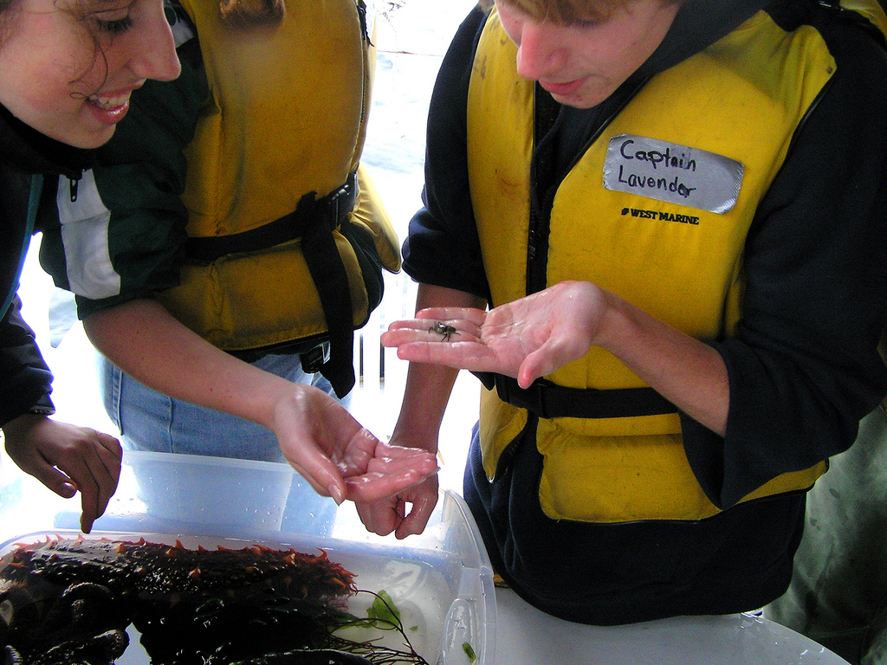
Focus of Interviews
What was Ocean Inquiry Project’s impact on:
Acquisition of, or improvement in, teaching skills
Level of confidence with regard to teaching
Changes in scientific knowledge
Belief and responses to Broader-Impacts expectations
Perceptions and evidence of impact on participants
Perspectives on working with diverse audiences
Notes:
Interviews Focused on Impacts
Teaching skills
Confidence
Scientific Knowledge—biological oceanographers learning about physical stratification and mixing, and vis versa.
BI expectations
Assessing impacts on participants
Working with diversity

Slide 6
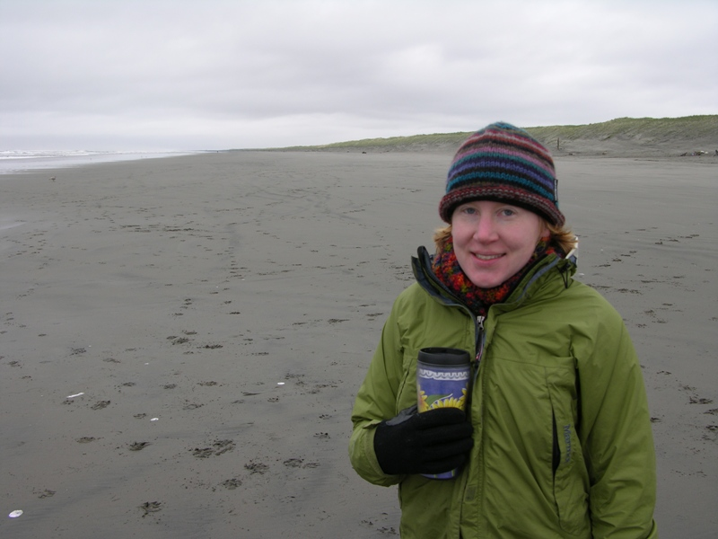
Findings of Impact from OIP Experiences
Changed attitudes toward teaching
Improved teaching skills and increased confidence
Expanded volunteer-scientists’ own knowledge
Amplified and affirmed belief in value of Education & Outreach and Broader Impacts requirements
Notes:
We had four major findings:

Slide 7
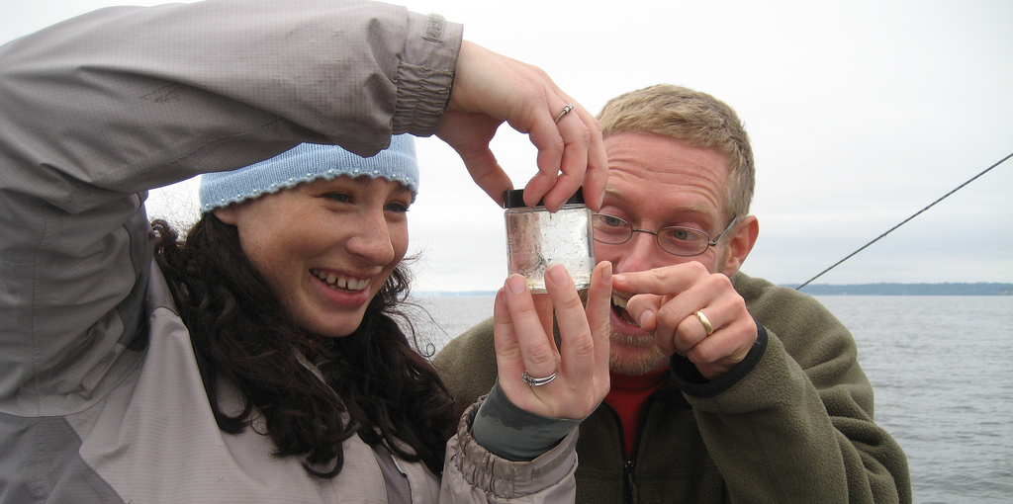
OIP changed attitudes toward teaching
Saw the power and potential for informal learning experiences being significant motivator
Convinced by direct observation that serious learning happens during OIP cruises
Gained new opportunities to talk about their own research and excitement about marine science
Increased scientists’ enthusiasm for teaching
Expanded learners’ sense of discovery and excitement - it’s contagious!
Notes:
OIP Changed Attitudes:
About power of informal learning to increase interest in marine science
Good evidence that learning happens for participants
Talking about their own research increases enthusiasm among learners
Which increases scientists’ enthusiasm for teaching
Excitement and discovery — serves both the learners and the scientists

Slide 8
OIP improved teaching skills and increased confidence
Learned skills to engage a broad range of learners
Learned how to respond to changing conditions or unexpected circumstances and to use them as “teachable moments”
Increased ability to use questioning/inquiry skills instead of lecturing/presentation
Learned the value of giving people time to think and reason their way to ideas
Increased confidence in working with wide range of backgrounds
Notes:
Scientists Acquired New Teaching Skills and Greater Confidence
Strategies for engaging learners
Working in changing conditions— Teachable moment – octopus coming out of old bottles brought up on scuba dive.
How to use questioning and inquiry; not lecture
***Time for learners to think and construct understanding
More confidence in teaching all learners

Slide 9
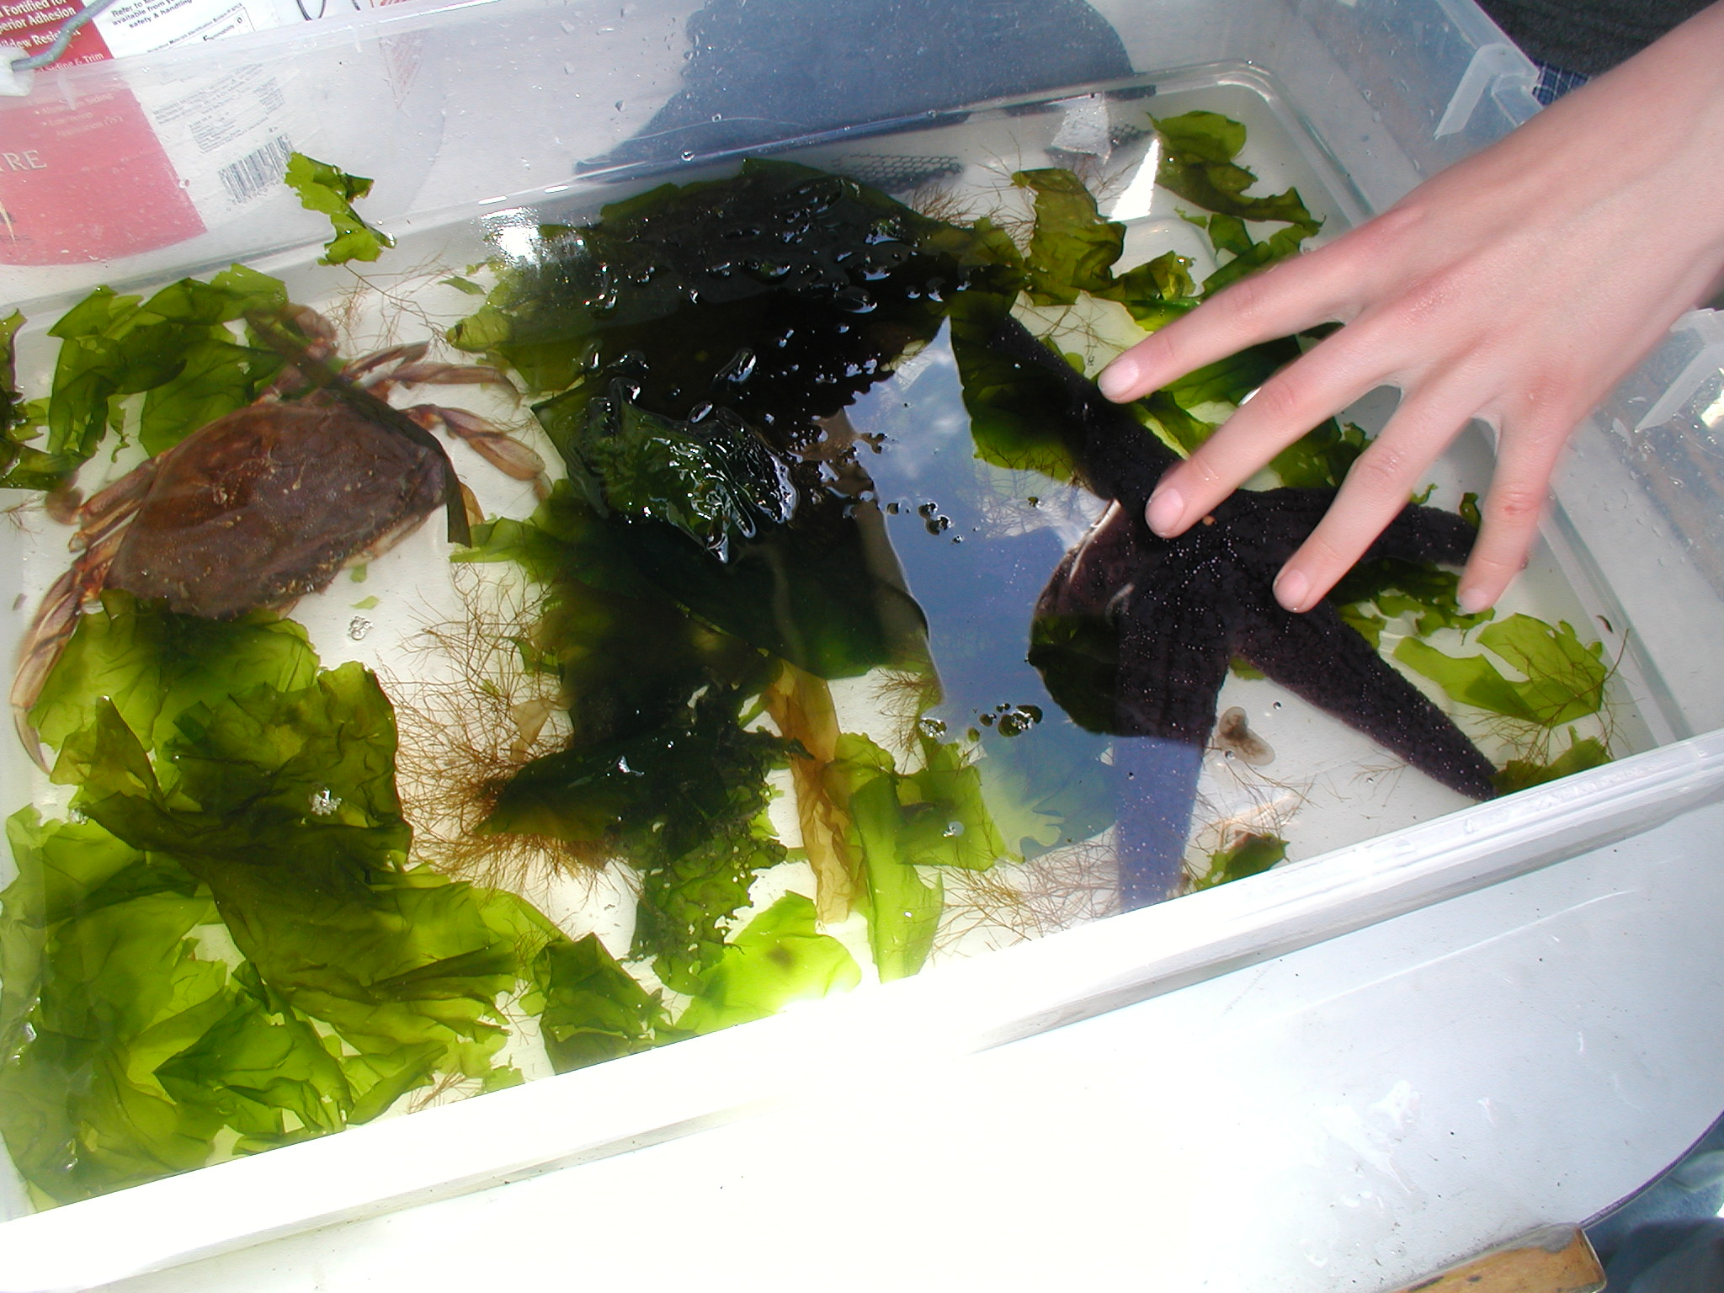
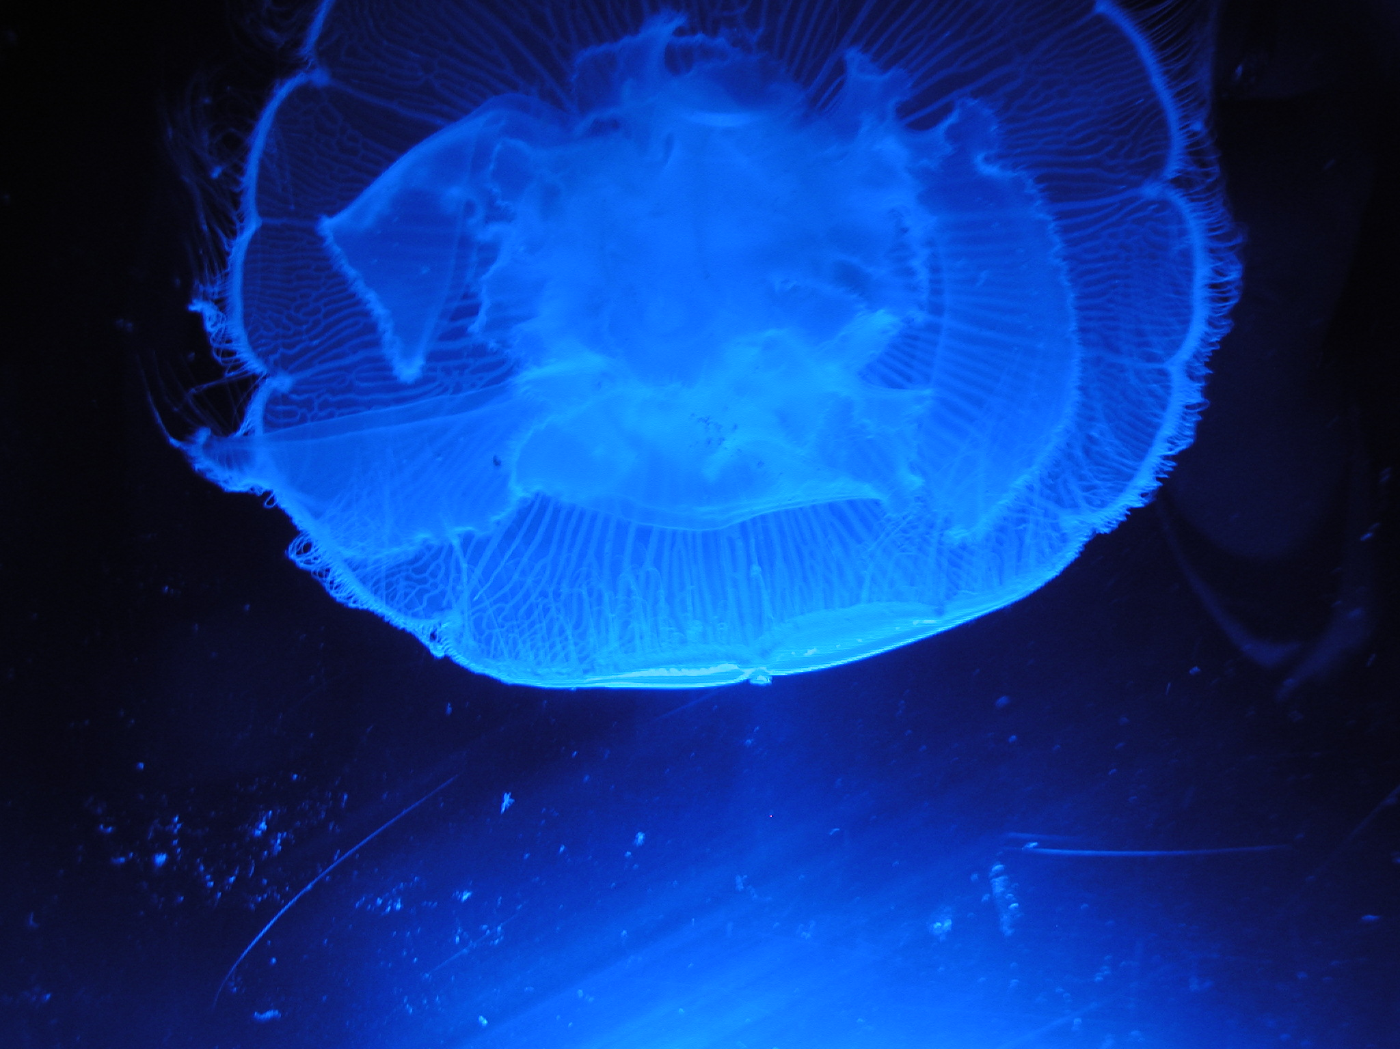
OIP expanded volunteer-scientists’ 0wn knowledge
Gained new technical skills and acquired new content knowledge
Learned about the Puget Sound ecosystem – an estuary with challenging issues
Found that one can usefully get out of one’s own ‘box’ by participating in full-range effort
Notes:
BUT Scientists also learned about science while volunteering with OIP
Technical skills—Biologists learning about CTDs,
Content knowledge— chemists learning about plankton, geologists learning about chemistry, etc.
Puget Sound Ecology

Slide 10
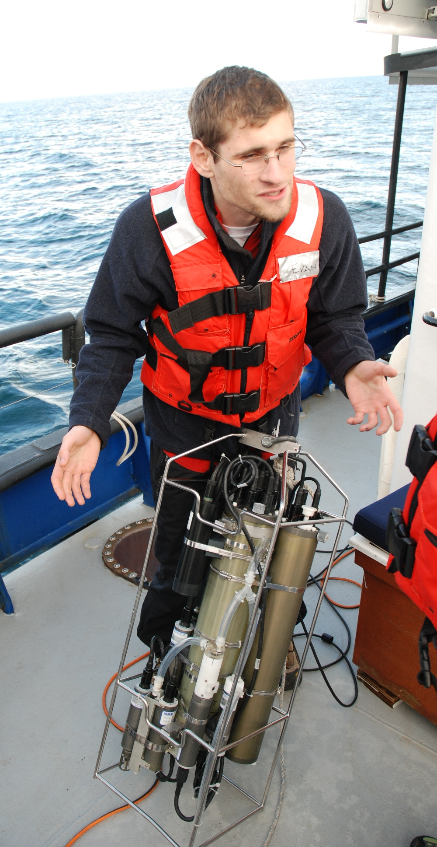
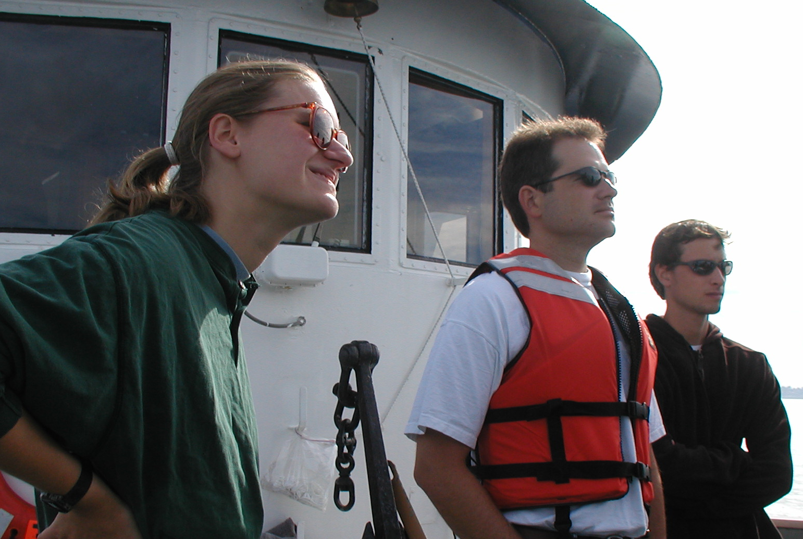
OIP affirmed and amplified belief in value of E&O and BI requirements
Reinforced view that doing Broader Impacts activities is both personally and professionally rewarding
Spurred new ideas for Education & Outreach
Found that conducting Broader Impacts with research projects makes results more relevant to all
Notes:
Volunteer-Scientists affirm Importance of Broader Impacts
Every scientist felt BI was critically important, but offered different reasons
Personally and professionally rewarding
Citizens learn how science is done; gain understanding of science knowledge
Increased funding because increases public mandate for research
OIP purred new ideas about how to do E&O
OIP does research; BI with research makes results relevant

Slide 11
Conclusions & “Take Aways”
Education & Outreach can be a two-way street – true “win-win” situations are possible:
Design E&O as learning experiences for BOTH scientists and client audiences
Recognize the power of real data collection for E&O that authentically engages and educates the public while contributing to research
Emphasize the fun-factor and excitement – it’s contagious for both!
soundviewevaluation.com www.oceaninquiry.org

